Slide 1
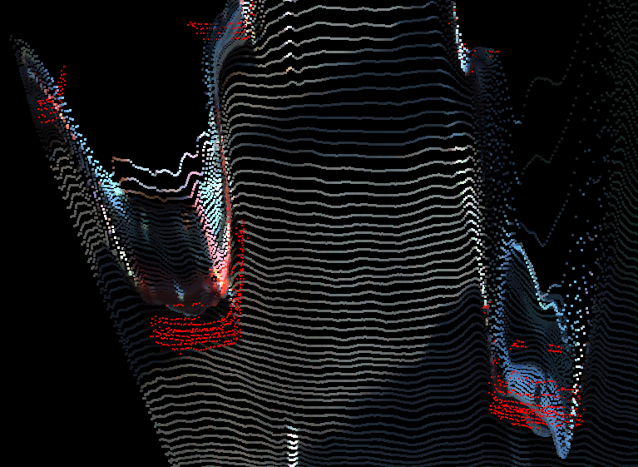
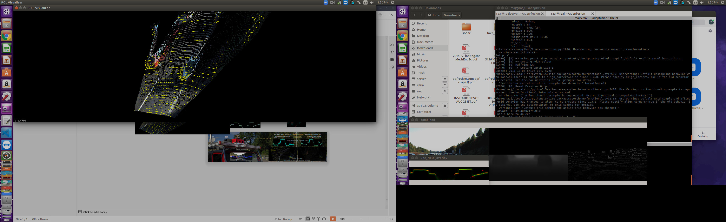
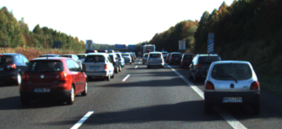
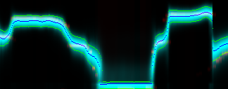
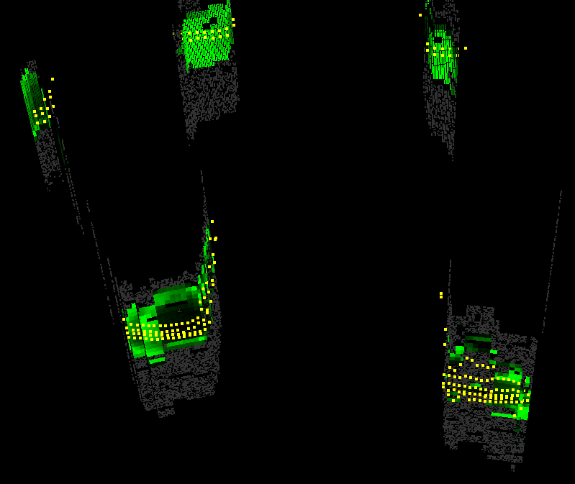
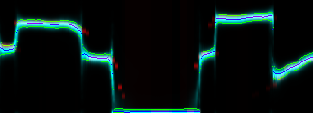
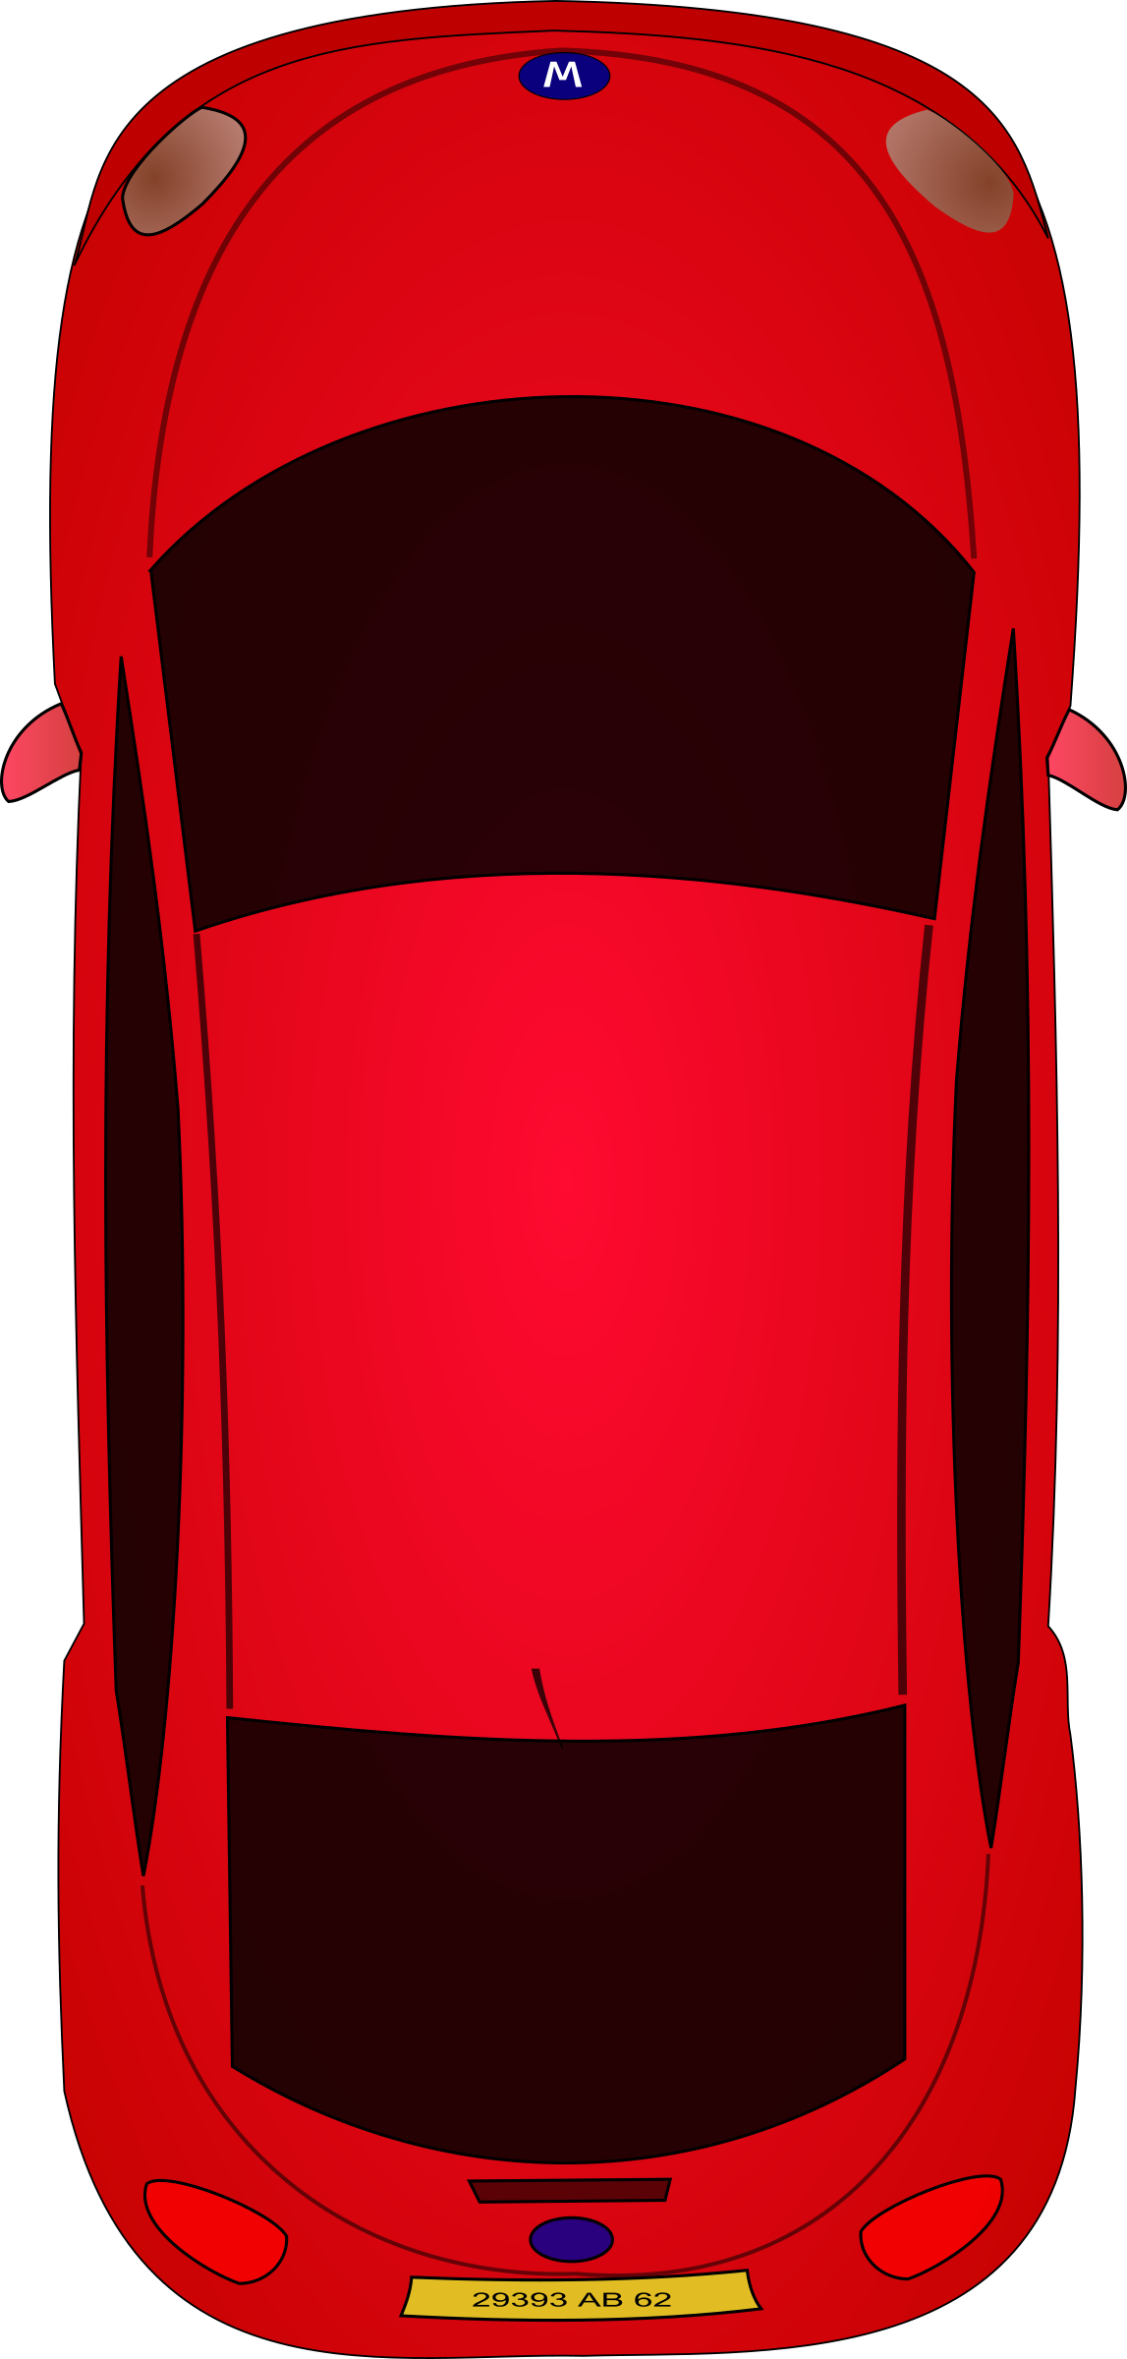
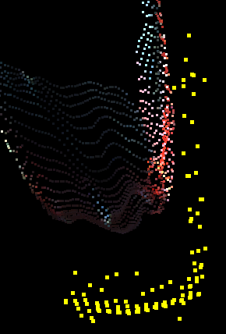
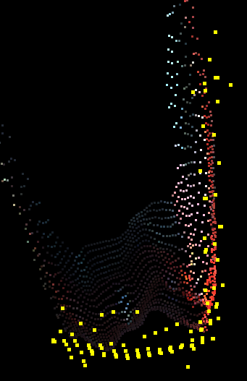
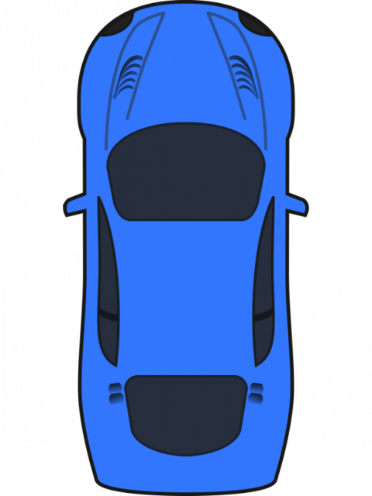
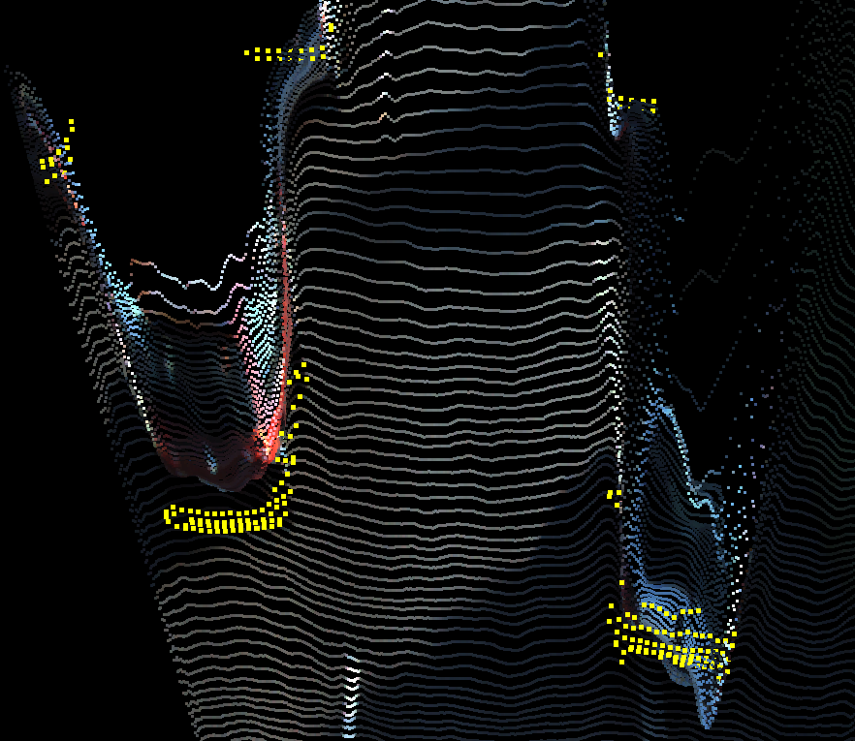
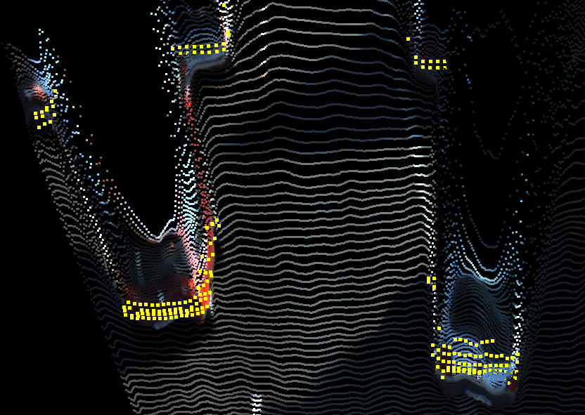
Used to Drive the Adaptive Light Curtain Laser
Lidar GT in Yellow
Expectation of Distribution produces pointcloud
Pixel Depth corrected over Time from Light Curtain Measurements
Topdown Predicted Uncertainty in Blue
Lidar GT in Red
40m
40m
5m
5m
RMSE: 1.2m
RMSE: 0.4m
NIR
Laser
(a) (b) (c) (d)

Slide 2
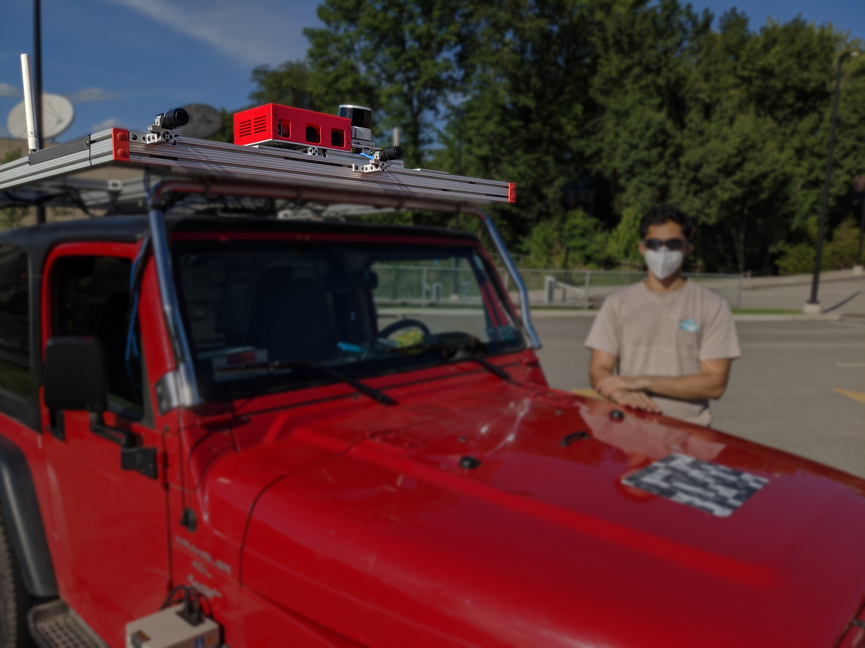
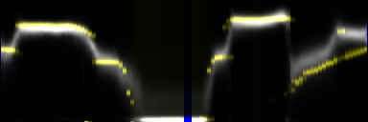
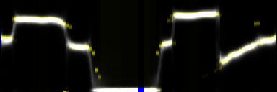
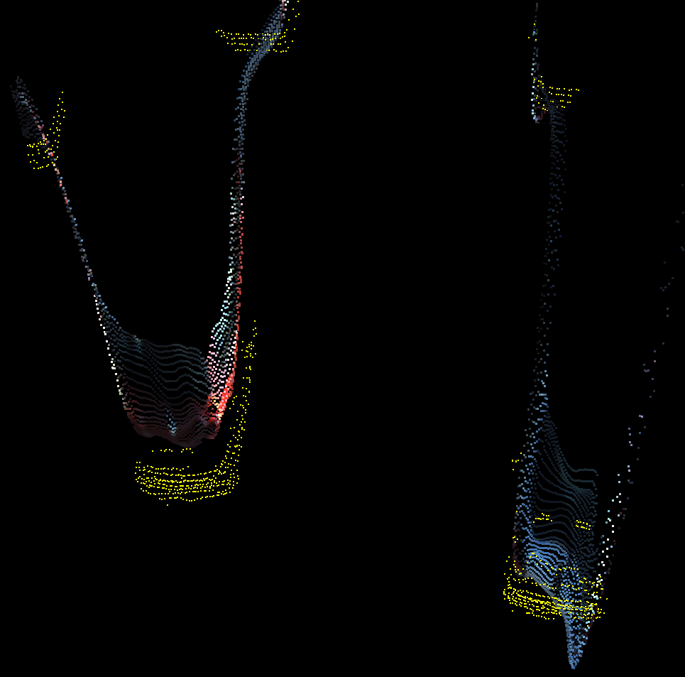
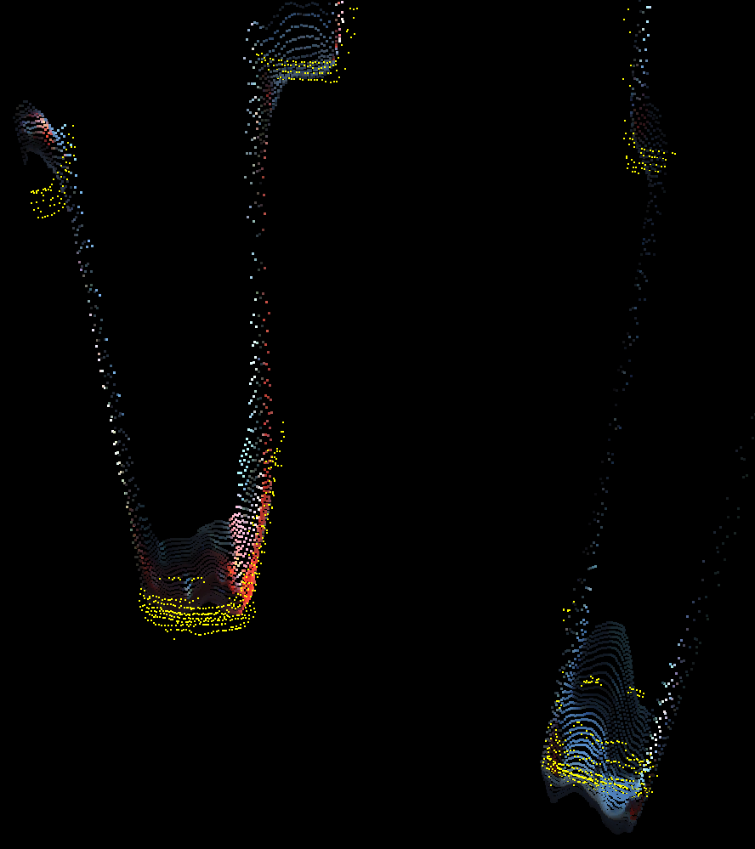
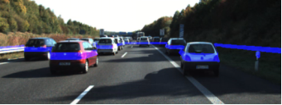
Used to Drive the Adaptive Light Curtain Laser
Lidar GT in Yellow
Expectation of Distribution produces pointcloud
Pixel Depth corrected over Time from Light Curtain Measurements
Topdown Predicted Uncertainty in Blue
Lidar GT in Red
Right
RGB
Light Curtain
GPS
Lidar
Left
RGB
Top Down Depth Uncertaintiy
Adaptive
Laser
Line
Rolling Shutter
NIR
Monocular Uncertainties corrected dynamically by Light Curtain
Left
RGB
Seen by Driver
NIR
Laser

Slide 3
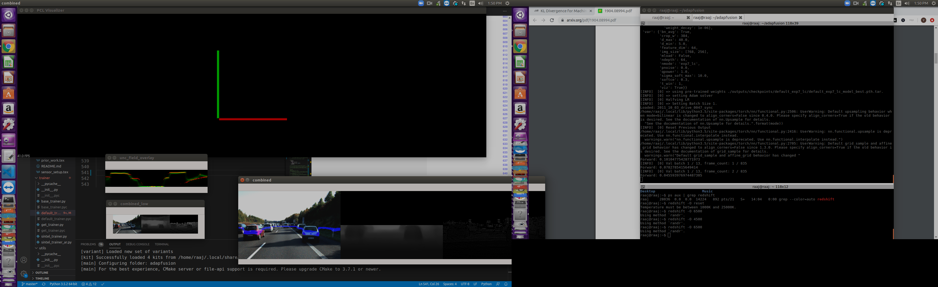
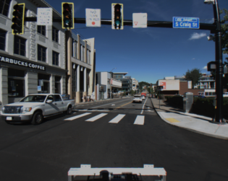
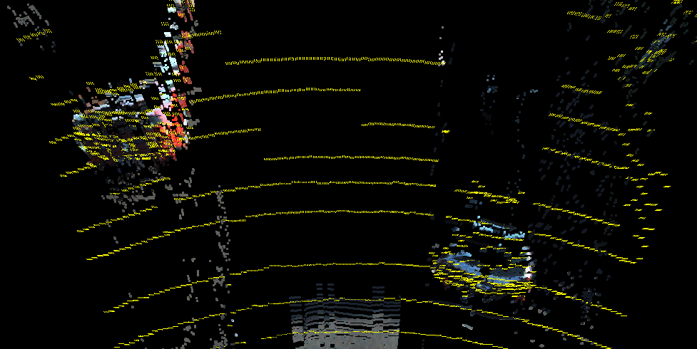
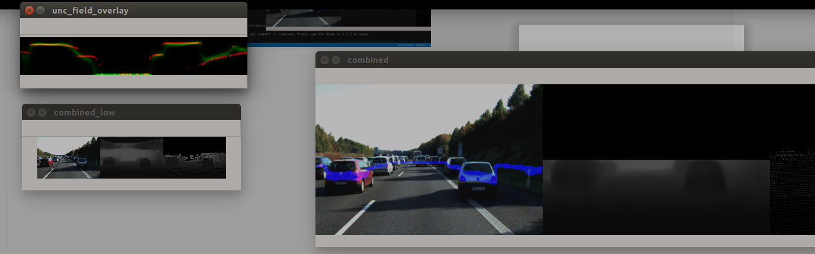

Slide 4
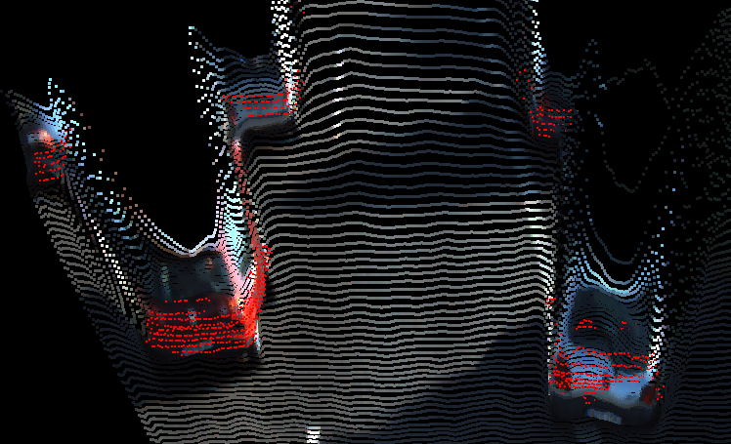
Used to Drive the Adaptive Light Curtain Laser
Lidar GT in Yellow
Expectation of Distribution produces pointcloud
Pixel Depth corrected over Time from Light Curtain Measurements
Topdown Predicted Uncertainty in Blue
Lidar GT in Red
Right
RGB
Light Curtain
GPS
Lidar
Left
RGB
Top Down Depth Uncertaintiy
Adaptive
Laser
Line
Rolling Shutter
NIR
Monocular Uncertainties corrected dynamically by Light Curtain
Left
RGB
Seen by Driver
NIR
Laser

Slide 5
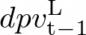
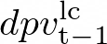
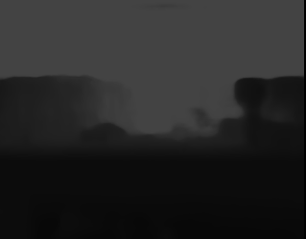
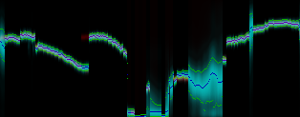
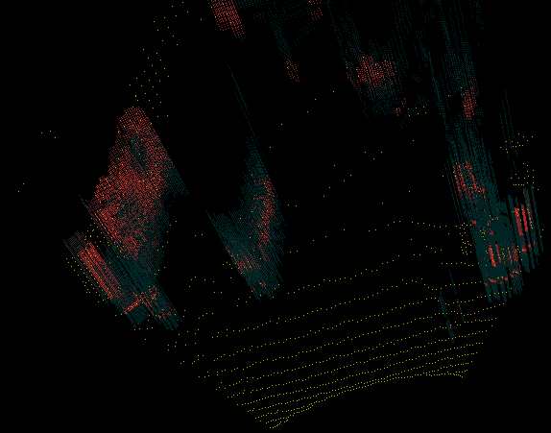
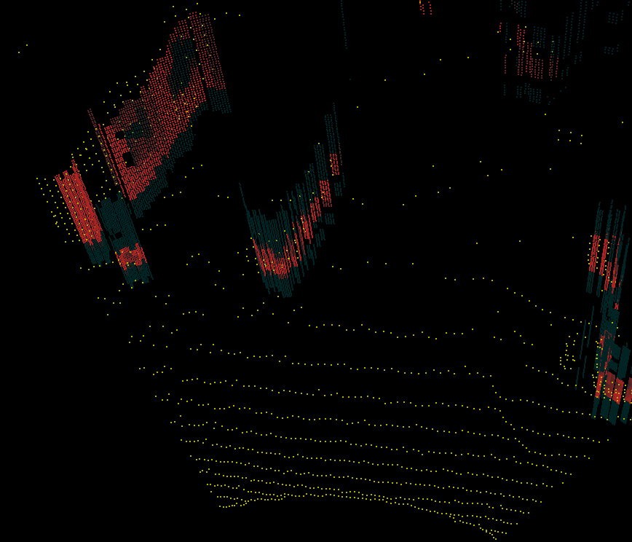
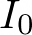
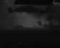
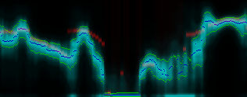
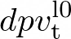
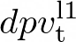
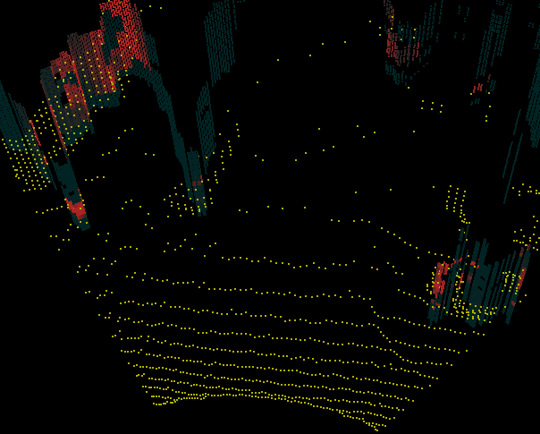
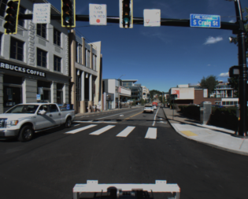
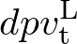
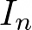
Images from N cameras
High Res DPV
Use DPV to place Light Curtains
Prev Frame DPV
LC DPV
Shared Encoder
2D Conv
+
Low Res DPV
+
+
Low Res DPV
Warp features based on R,T
Differentiable Homography
DPV Fusion Network
3D Conv
Decoder
2D Conv
...
...
Shared Encoder
2D Conv
+
+

Slide 6
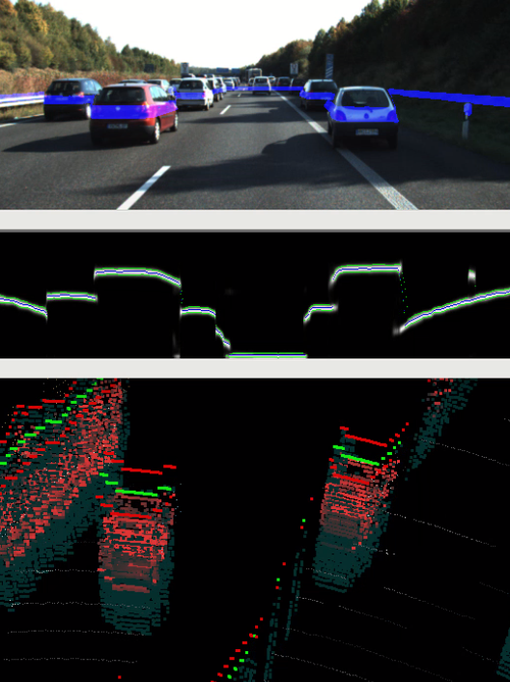
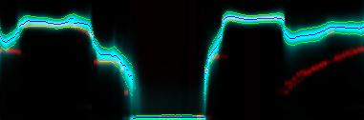
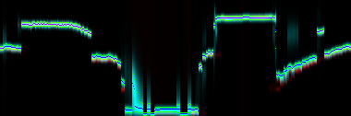
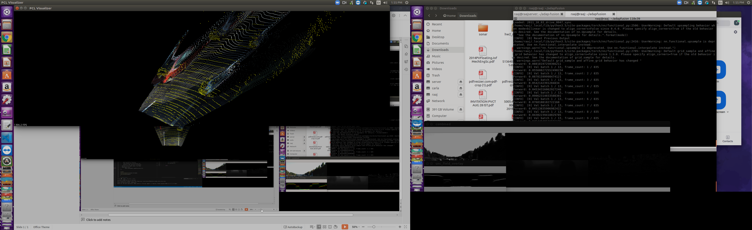
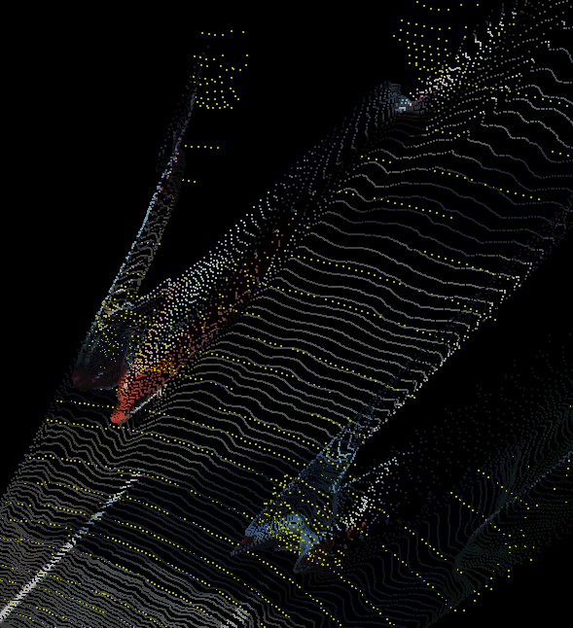
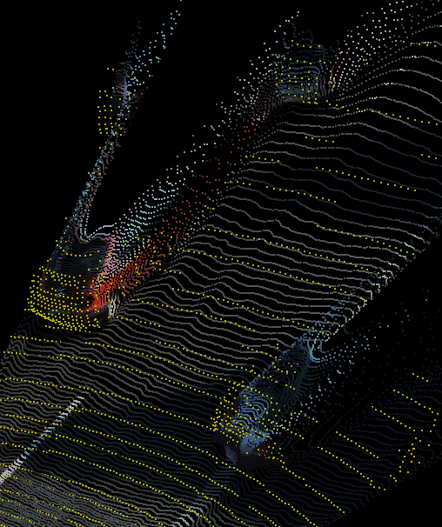
Per Pixel Depth Distribution Predicted from Monocular RGB
Used to Drive the Adaptive Light Curtain Laser
Pixel Depth corrected over Time from Light Curtain Measurements
Topdown Predicted Uncertainty in Blue
Lidar GT in Red
Lidar GT in Yellow
Expectation of Distribution produces pointcloud

Slide 7
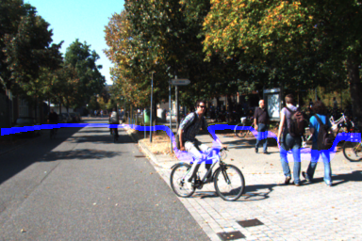
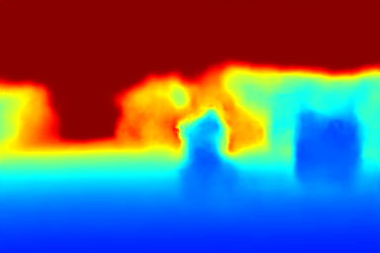
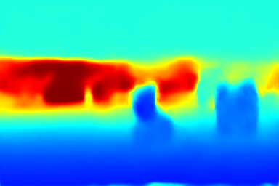
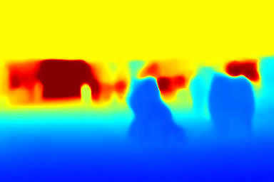
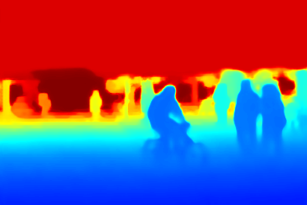
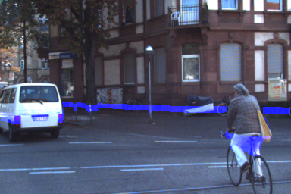




replace with real experiment
RGB
Monocular
Monocular with Light Curtain
Stereo
Lidar Upsampling

